Slide 1
COL874: Advanced Compiler Techniques
Module 161-165 (Pipelining and Blocking)
By: Harsh Yadav

Slide 2
Introduction to Pipelining (Mod161)
It’s kind of a different parallelization scheme for affine loop nest.
Different from synchronization free or sync-based (barriers).
Probably heard about 5-stage pipeline of instruction execution at hardware level in other courses.
Inst. Fetch - Decode - Execute - Memory - Writeback.
We will use similar concept on the software side (at compiler level).
Let’s see an example...
Notes:
We have seen synchronisation free parallelization so far. In barriers, all the threads are synchronised at the barrier point.

Slide 3
for (i = 0; i <= M; i++) {
for(j = 0; j <= N; j++) {
X[i] = X[i] + Y[j][i];
}
}
The outer loop is parallelizable but…
If y is laid out in row-major form?
Each processor memory footprint is high -> Cache misses.
Accesses a different cache line on each inner loop iteration.
In real case, L1 cache not used.
Cache miss could be very expensive then parallelization:
All cache misses from different processors will go to memory -> increasing load on memory.
Depends on machine.
Y[j,0]
Y[j,1]
...
...
Mem
Y[j,0]
Y[j,1]
CPU0
CPU1
Notes:
Depends on the machine that whether cache miss is much expensive. Misses gets serialized on memory.

Slide 4
for (i = 0; i <= M; i++) {
for(j = 0; j <= N; j++) {
X[i] = X[i] + Y[j][i];
}
}
Better Cache Usage for each CPU.
Spatial locality is good.
Benefits
Is it possible that…
CPU_{j} accesses Y[j,0], Y[j,1], Y[j,2],.....
And possibly X[0], X[1], X[2],......
Data Dependency Alert!!
Each processor will write to X[0], X[1],...
But after CPU0 written to X[0] it doesn’t care. So we can pipeline the accesses.
Problem?
Notes:
Depends on the machine that whether cache miss is much expensive. Misses gets serialized on memory.

Slide 5
for (i = 0; i <= M; i++) {
for(j = 0; j <= N; j++) {
X[i] = X[i] + Y[j][i];
}
}
O(n) Synchronisation (Somewhat Loose, everything doesn’t have to happen in lock step.)
One Task | N stages
(Each Column is a Stage).
CPU0 (stage0) | CPU1(stage1) | CPU2(stage2)
X[0]+=Y[0,0]
X[1]+=Y[0,1] | X[0]+=Y[1,0]
X[2]+=Y[0,2] | X[1]+=Y[1,1] | X[0]+=Y[2,0]
... | X[2]+=Y[1,2] | X[1]+=Y[2,1]
1st Task
2nd Task
3rd Task
Notes:
There are other ways of synchronisation also.
First iteration of CPU1 should execute after first iteration of CPU0.
Each CPU is the specialist for a particular stage.
Its kind of a wavefront. CPU1 keeps signalling CPU2

Slide 6
for (i = 0; i <= M; i++) {
for(j = 0; j <= N; j++) {
X[i] = X[i] + Y[j][i];
}
}
Fetch - Decode - Execute - Mem - WB
It’s like each CPU is specialised for one particular job.
Pipelining requires a loop depth of >= 2.
Then iterations of outer loop can be counted as tasks.
Iteration of the inner loop are counted as stages.
Each processor will be specialized for the particular stage.
Notes:
Depends on the machine that whether cache miss is much expensive. Misses gets serialized on memory.

Slide 7
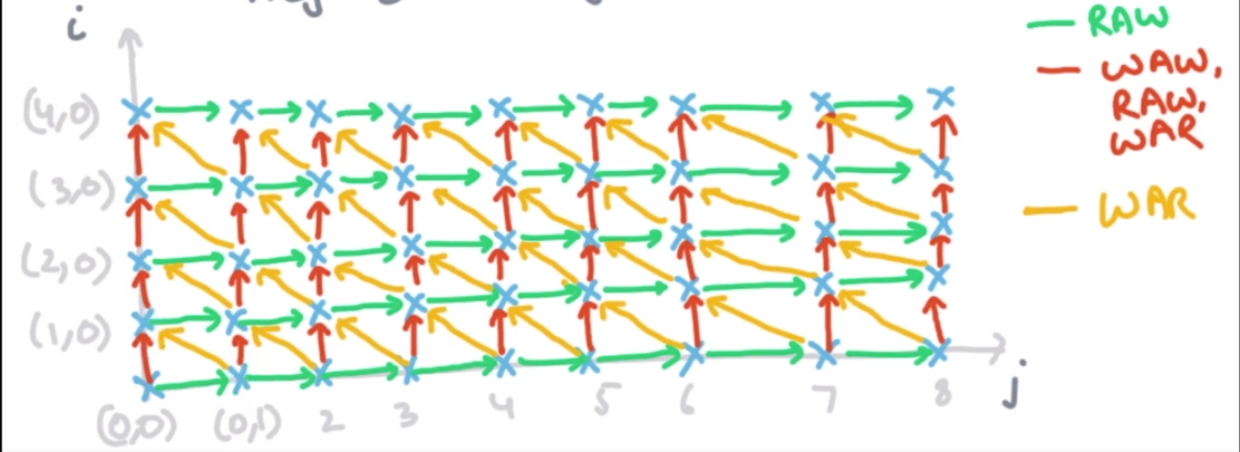
SOR Example(Mod162)
for (i = 0; i <= M; i++) {
for(j = 0; j <= N; j++) {
X[j+1] = (X[j] + X[j+1] + X[j+2])/3;
}
}
SOR (Successive Over Relaxation)
It’s kind of relaxing the value using the neighbours.
N ∝ Size of X.
M ∝ Number of relaxations.
Data Dependencies...
Green one: at jth itr write to X[j+1]
at j+1th itr read to X[j+1]
Red one: Between outer iterations because they are writing and reading to same elements.
Yellow one: (0,1) read X[1].
(1,0) write X[1].
(0,1) < (1,0) so WAR
Notes:
This type of operation used in the blurring in image processing.

Slide 8
for (i = 0; i <= M; i++) {
for(j = 0; j <= N; j++) {
X[j+1] = (X[j] + X[j+1] + X[j+2])/3;
}
}
Sync-Free Parallelism?
Not possible. Whole graph is connected. Any two points in the graph are dependent.
Is it Pipelinable?
I want it to divide in tasks, task have stages and stages of first task have one way dependency to stages of second task and so on.
Wavefront Phenomena.
Not bidirectional dependencies
Notes:
We have seen synchronisation free parallelization so far. In barriers, all the threads are synchronised at the barrier point.

Slide 9
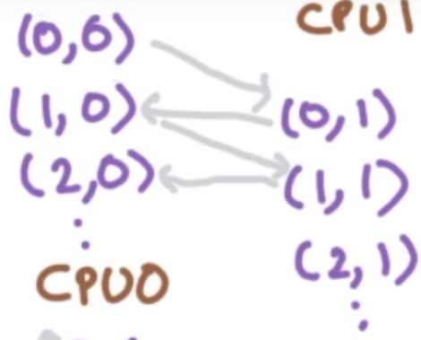
for (i = 0; i <= M; i++) {
for(j = 0; j <= N; j++) {
X[j+1] = (X[j] + X[j+1] + X[j+2])/3;
}
}
Lets try out the simple way
Above will not work because there are dependency between stages.
Notes:
We have seen synchronisation free parallelization so far. In barriers, all the threads are synchronised at the barrier point.

Slide 10
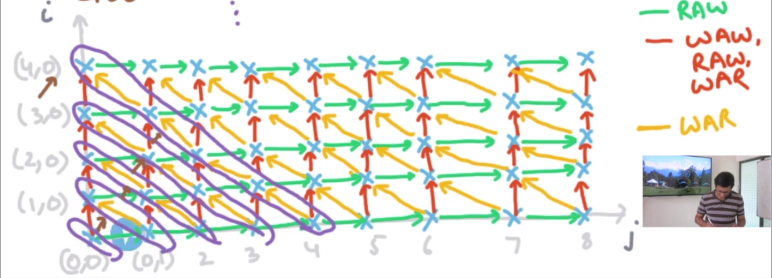
for (i = 0; i <= M; i++) {
for(j = 0; j <= N; j++) {
X[j+1] = (X[j] + X[j+1] + X[j+2])/3;
}
}
We can try doing it diagonally
Notes:
We have seen synchronisation free parallelization so far. In barriers, all the threads are synchronised at the barrier point.

Slide 11
Fully Permutable Loop(Mod163)
How do distinguish between pipelinable and non-pipelinable loop?
A loop is fully permutable if it can be permuted arbitrarily without changing the meaning of the program.
for (i = ...) {
for(j = ...) {
for(k = ...)
}
}
for (j = ...) {
for(i = ...) {
for(k = ...)
}
}
for (k = ...) {
for(j = ...) {
for(i = ...)
}
}
∀ i₁, i₂
(i₁ < i₂) && (p(i₁) > p(i₂)) => No data dependence between i₁ and i₂.
Notes:
We have seen synchronisation free parallelization so far. In barriers, all the threads are synchronised at the barrier point.

Slide 12
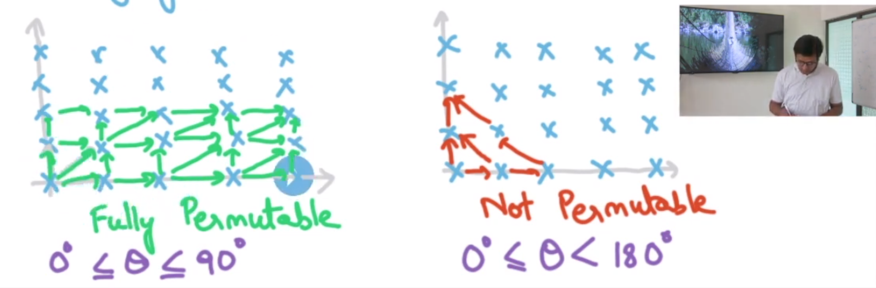
A loop is fully permutable if it can be permuted arbitrarily without changing the meaning of the program.
In fully permutable,
See (0,1) and (2,0) they have no data dependency. So the order of execution can be changed.
Data dependencies are from strictly lower (i,j) to strictly larger values of (i,j).
If all the edges are acute, then loop is permutable.
Notes:
Try to change the axis.

Slide 13
Change axis in SOR
for (i = 0; i <= M; i++) {
for(j = 0; j <= N; j++) {
X[j+1] = (X[j] + X[j+1]
+ X[j+2])/3;
}
}
for (i = 0; i <= M; i++) {
for (jd = i; jd <= i+N; jd++) {
X[jd-i+1] = (X[jd-i] + X[jd-i+1]
+ X[jd-i+2])/3;
}
}
i
jd
1 0
1 1
i
j
Use fourier motzkin method to find the bounds
Notes:
We have seen synchronisation free parallelization so far. In barriers, all the threads are synchronised at the barrier point.

Slide 14
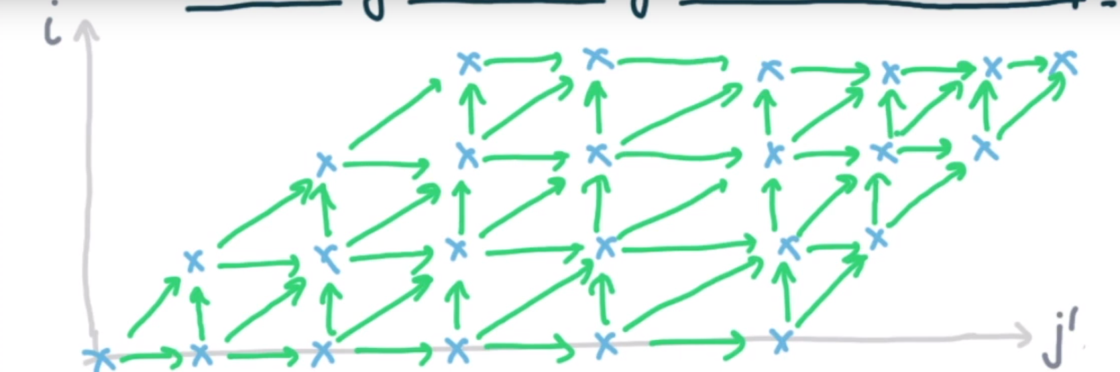
for (i = 0; i <= M; i++) {
for (jd = i; jd <= i+N; jd++) {
X[jd-i+1] = (X[jd-i] + X[jd-i+1]
+ X[jd-i+2])/3;
}
}
Now you can see all the dependencies are now in the acute angle.
Notes:
We have seen synchronisation free parallelization so far. In barriers, all the threads are synchronised at the barrier point.

Slide 15
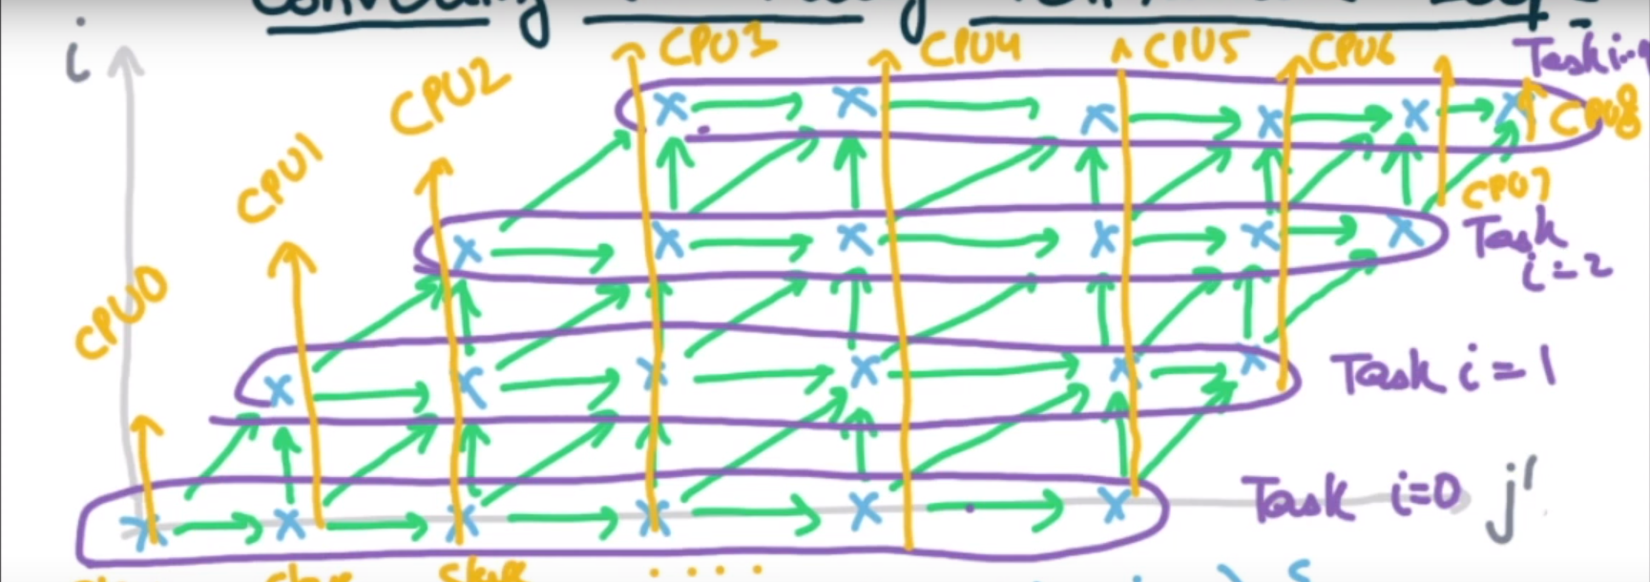
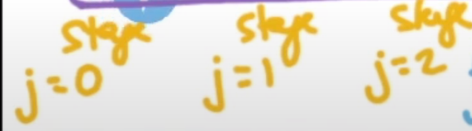
for (i = 0; i <= M; i++) {
for (jd = i; jd <= i+N; jd++) {
X[jd-i+1] = (X[jd-i] + X[jd-i+1]
+ X[jd-i+2])/3;
}
}
For each task i:
CPU j waits for CPU j-1 to signal before exec
O(N) synchronization. N tasks.
No need to wait at boundary points.
Notes:
Left boundary doesn’t need to wait and right boundary doesn’t need to send the signal.

Slide 16
Pipeline Code Generation (Mod164)
A loop with k outermost fully permutable loops can be structured as a pipeline with O(k-1) dimensions with O(n) synchronisation.
n : number of iterations of the inner loop.
Ex: SOR example k=2.
for (i = 0; i <= M; i++) {
for(j = 0; j <= N; j++) {
X[j+1] = (X[j] + X[j+1] + X[j+2])/3;
}
}

Slide 17
Pipelining Fully Permutable Loop
Ignoring boundary condition, a processor p can execute stage ith of a task only after processor p-1 executed i-1th stage of that task.
To do this we use Condition Variables:
On every iteration, processor p executes wait(p-1) before the body and signal(p+1) after the body.
Notes:
We have seen synchronisation free parallelization so far. In barriers, all the threads are synchronised at the barrier point.

Slide 18
Total Number of CPUs = M+N+1
Each CPU_{j} is specialize for stage j. So lets generate the code for the CPU_{j}
CPU j ∈ [0, M+N]
i >= 0 and i >= j-N
i <= M and i <= j
for (i = 0; i <= M; i++) {
for (jd = i; jd <= i+N; jd++) {
X[jd-i+1] = (X[jd-i] + X[jd-i+1]
+ X[jd-i+2])/3;
}
}
Notes:
Left boundary doesn’t need to wait and right boundary doesn’t need to send the signal.

Slide 19
Total Number of CPUs = M+N+1
Each CPU_{j} is specialize for stage j. So lets generate the code for the CPU_{j}
CPU j ∈ [0, M+N]
i >= 0 and i >= j-N
i <= M and i <= j
for (i = 0; i <= M; i++) {
for (jd = i; jd <= i+N; jd++) {
X[jd-i+1] = (X[jd-i] + X[jd-i+1]
+ X[jd-i+2])/3;
}
}
for (i = max(0, j-N); i <= min(j, M); i++) {
if(j > i) wait(j-1); // If node is left boundary node or not.
X[j-i+1] = (X[j-i] + X[j-i+1] + X[j-i+2])/3;
if(j < i+N) signal(j+1);// If node is right boundary node or not.
}

Slide 20
Pipelining Vs Barrier
Barrier has a lock-step semantics.
Faster Cpus need to wait more for slower threads.
Pipeline has greater level of asynchronous behavior.
Wait/signal
Relaxed wavefront
Eg. Keep faster cpus can be called first for the execution and slower cpus can be called later.
One cpu can be slower but the other cpus may not have to wait for it.
Notes:
We have seen synchronisation free parallelization so far. In barriers, all the threads are synchronised at the barrier point.

Slide 21
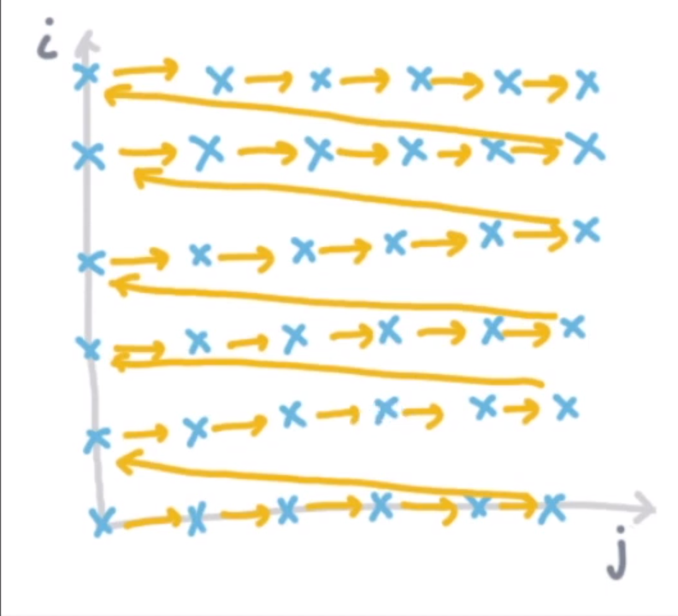
Blocking (Mod165)
for (ii = 0; ii <= n; i+=b)
for (jj = 0; jj <= n; j+=b)
for (i = ii*b; i <= min(n, (ii+1)*b); i++)
for (j = jj*b; j <= min(n, (jj+1)*b); j++)
s;
for (i = 0; i <= n; i++)
for (j = 0; j <= n; j++)
S;
-> Assume no Data Dependencies here.
-> Yellow lines are execution order.
Blocking is changing the execution order.
When is it okay to do this? Why its good?
Why part already discussed. Matrix Mul.
Choosing b for greater cache locality. Gives both the spatial and temporal locality.
How compiler can do it?
What are the conditions on s such that we can do blocking?
Notes:
We have seen synchronisation free parallelization so far. In barriers, all the threads are synchronised at the barrier point.

Slide 22
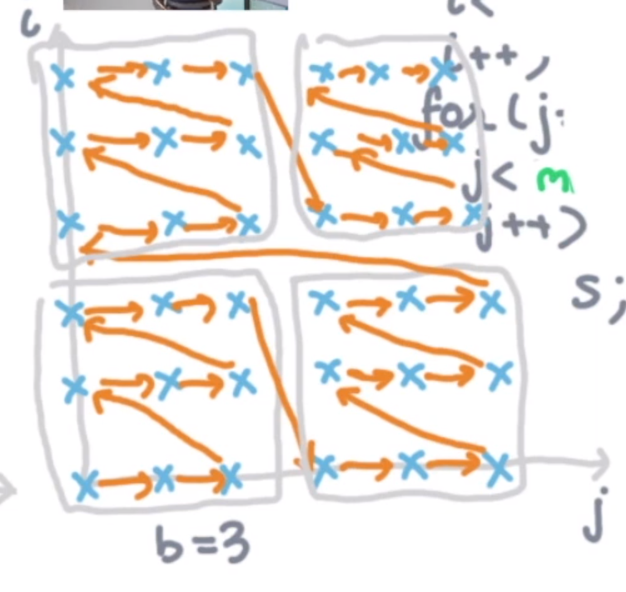
for (ii = 0; ii <= n; i+=b)
for (jj = 0; jj <= n; j+=b)
for (i = ii*b; i <= min(n, (ii+1)*b); i++)
for (j = jj*b; j <= min(n, (jj+1)*b); j++)
s;
for (i = 0; i <= n; i++)
for (j = 0; j <= n; j++)
S;
-> Assume no Data Dependencies here.
-> Yellow lines are execution order.
Notes:
Discuss about the advantages of the blocking here.

Slide 23
When is it possible to do blocking?
Lets see this
s: A[B[i,j]] = f(i,j)
We can’t do blocking here because there is a higher chance that there are dependencies (let’s say (2,1), (0,4)) and reordering them will give different results.
for (ii = 0; ii <= n; i+=b)
for (jj = 0; jj <= n; j+=b)
for (i = ii*b; i <= min(n, (ii+1)*b); i++)
for (j = jj*b; j <= min(n, (jj+1)*b); j++)
s;
Relative order changed
Notes:
Discuss about the advantages of the blocking here.

Slide 24
When is it possible to do blocking?
If order has changed, then there should not be data dependence between them.
Relative order remain same for 0 <= θ <= 90.
So all data dependencies should be at acute angle only.
Ex: check exec order in figure.
Notes:
Discuss about the advantages of the blocking here. Purple lines are not dependencies

Slide 25
When is it possible to do blocking?
If order has changed, then there should not be data dependence between them.
Sufficient condition: whenever θ > 90 between two itr points, then there is no data dependency.
Relative order may change for 90 < θ < 180.
Relative order change ⇒ θ > 90.
Whenever θ > 90 ⇏ Relative order change.
Notes:
Discuss about the advantages of the blocking here.

Slide 26
It is always possible to block fully permutable loops.
They share same condition.
In matrix multiplication example we did 3-level blocking.
Data dependence coming from C.
If (i₁ == i₂) && (j₁ == j₂)
Fully permutable? Yes. Check every order you will see. Commutative property of addition.
for (i = 0; i <= n; i++) {
for (j = 0; j <= n; j++) {
for (k = 0; j <= n; j++) {
C[i,j] += A[i,k] * B[k,j];
}
}
}

Slide 27
Thank You
Harsh Yadav
(These slides are the summary of Module 161-165 of Compiler Design. For more details check Youtube Playlist on compilerai channel).

